Slide 1
Fall Reporting Tasks
2023-2024 School Year

Slide 2
SIRS Timeline & MAARS due dates
The SIRS Timeline is posted under Quick Links on the IRS website:
https://www.nysed.gov/information-reporting-services
MAARS dues dates are always on Thursday the day before deadline posted on the SIRS Timeline
Work backwards from due dates
If data is due Thursday, 1/25…
Then plan to have your data loaded 2 weeks before on Thursday, 1/11
Plan to verified L2RPT reports on Monday 1/15 so that you can make corrections by Thursday, 1/18
This will leave you one last week for final corrections

Slide 3
L2RPT Refresh Schedule
L2RPT Refresh Schedule: https://www.p12.nysed.gov/irs/level2reports/#time

Slide 4
Working backwards from due dates
JANUARY 2024
Sun | Mon | Tue | Wed | Thu | Fri | Sat
 | 1 | 2 | 3 | 4 | 5 | 6
7 | 8 Load data into Level 0 | 9 Resolve any errors | 10 | 11 Push data to Level 1 | 12 | 13
14 | 15 Review L2RPT report & correct errors | 16 | 14 | 18 Push data to Level 1 | 19 | 20
21 | 22 Review L2RPT report & correct errors | 23 | 24 | 25 Data due Last chance to push data to Level 1 | 26 | 27
Student Digital Resources deadline is Friday, Jan. 26
The data is due in Level 1 on Thursday, Jan. 25
Working backwards
Load data by Thursday, 1/11 & push to L1
Plan to verified L2RPT reports on Monday 1/15 so that you can make corrections by Thursday, 1/18
This will leave you one last week for final corrections

Slide 5
BEDS Day Collection (Districts & Charters only)
Students enrolled on first Wednesday of October (10/4/23)
Demographics (Student Lite)
District of Residence Code
Enrollments (School Entry/Exit)
Programs
Free (5817) & Reduced (5806) Lunch
Poverty (0198)
Data due Thursday, January 4

Slide 6
Data Quality Report Card
In Regional Data Warehouse in Verification Reports Folder

Slide 7
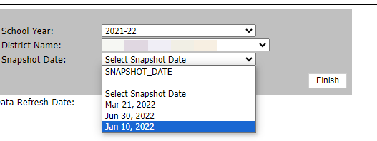
L2RPT BEDS Reports
Snapshot Dates
January 5, 2024
March 15, 2024
August 16, 2024
Why are there 2 SIRS reports for each one?
SIRS reports without the .1 (SIRS-312) will show you the most current data
SIRS report with the .1 (SIRS-312.1) will show you the data that was pulled on the snapshot due date

Slide 8
SIRS-312 BEDS Day Enrollment for State Aid
Who is included
Students enrolled on BEDS day with a 0011 enrollment code
Purpose
State aid calculations
The majority of state aid is reserved for students based on where they are enrolled
Textbook and transportation aid is reserved for students based on their district of residence
What Report Shows
Resident students who are enrolled outside of the district
Sp. Ed. District-placed
BOCES
Homebound/Home Tutored
Non-resident students who are enrolled in the district
Parentally placed students (teacher kids, tuition students)
Incarcerated youth in correctional facilities in the district

Slide 9
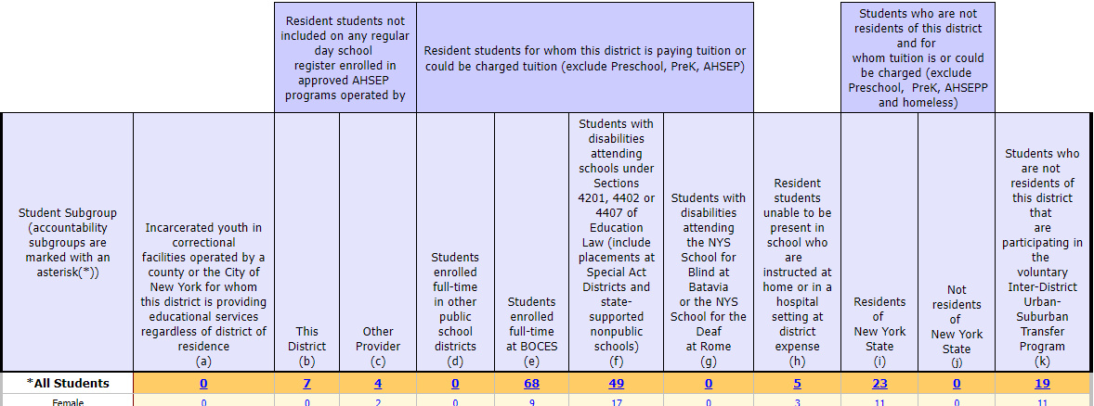
SIRS-312 (Districts only)

Slide 10
SIRS-313 BEDS Day Enrollment by Location & Subgroup
Who is included
Students enrolled on BEDS day with a 0011 enrollment code
Purpose
Data in the District BEDS Total will be recognized as official BEDS grade-by-grade enrollment for all districts
What Report Shows
This report presents counts of students by grade (Pre-Kindergarten [Pre-K] to grades 12, ungraded elementary and ungraded secondary) for All Students and for the student subgroups of gender, race/ethnicity, disability status, English proficiency status, and economic status.
Note: BEDS enrollment does not include preschool (PS) students, AHSEP (Alternative High School Equivalency Preparation Programs) enrolled students (GD), homebound students (Location Code ending in “0777”), home schooled students (Location Code ending in “0888”), or out-of-district placement students

Slide 11
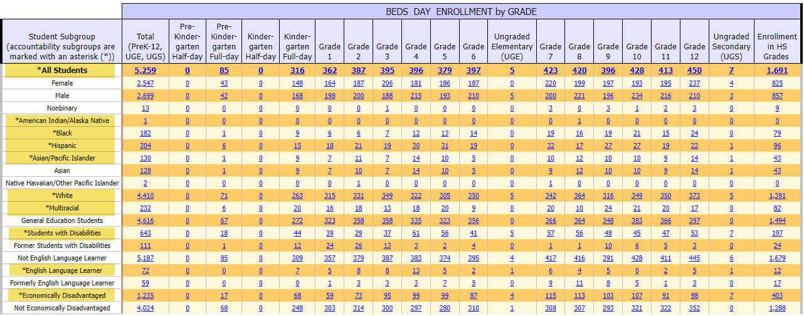
SIRS-313

Slide 12
SIRS-314 BEDS Day Enrollment by District of Residence
Who is included
Students enrolled on BEDS day with a 0011 enrollment code
Purpose
District of Residence is used in calculations for textbook and transportation aid. It also provides insight about the districts where charter school students reside
What Report Shows
This report shows counts of students enrolled in your district by grade and by their District of Residence
In this report…
if all enrolled students are residents of the district in which they are enrolled, then the report will show one “detail” row with all enrolled students appearing as residents of that district and one “All Students” row that will be the same as the detail row.
if students are from multiple districts of residence, the report will show multiple rows displaying counts of students for each district of residence as well as a row for all students combined.

Slide 13
SIRS-314
This report shows the District of Residence of students enrolled in your district.
All data in this report has been reported by your district

Slide 14
SIRS-319 BEDS Day Enrollment in Public & Charter Schools by Resident District
Who is included
Students enrolled on BEDS day with a 0011 enrollment code
Purpose
District of Residence is used in calculations for textbook and transportation aid. It also provides insight about the districts where charter school students reside
What Report Shows
This report shows counts of resident students by grade and by school district or charter school of enrollment
Resident students enrolled in schools within district of residence as well as resident students enrolled in schools outside of district of residence are included.
This report shows data being reported by your district as well as other districts and charter schools
In this report, if no resident students are enrolled in charter schools or school districts other than the district of residence, the report will be blank

Slide 15
SIRS-319 (Districts only)
This report shows where your resident students are enrolled.
Data in this report has been reported by your district and other districts & charter schools.

Slide 16
SIRS-323 Free and Reduced Price Lunch Eligible Students Enrolled on BEDS Day
Who is included
Students enrolled on BEDS day with a 0011 enrollment code
Students have either
5817 (Free Lunch Program) to be eligible for Free Lunch
5806 (Reduced Price Lunch Program) to be eligible for Reduced Price Lunch
Purpose
BEDS Day FRPL eligible counts are used for many purposes including:
State aid calculations;
generating targeted federal program aid;
reporting in New York State Report Cards;
reporting to the media.
What Report Shows
This report presents district/school and charter school level counts of students by grade cluster: PreKindergarten alone; Grades K-6 and ungraded elementary together; and Grades 7-12 and ungraded secondary together
While the FRPL eligible count is as of BEDS Day, subgroup status is determined using program service data reported anytime during the school year. That is, if a student enrolled on BEDS Day is FRPL eligible and was a member of a subgroup or program category at any point in the school year, then that student will be counted as a member of that subgroup on this report.

Slide 17
PD Reporting: SE BEDS Day Snapshot
Demographics (Student Lite)
Enrollments (School Entry/Exit)
Type of Disability (Frontline IEP)
Programs Fact Extract > Type of Disability
SE Snapshot (Frontline IEP)
October Snapshot Extract
Data due Thursday, January 4

Slide 18
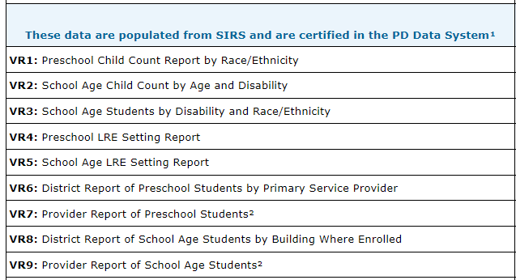
SE BEDS Day Snapshot – VR 1-9

Slide 19
Overview of PD Snapshots

Slide 20
L2RPT and PD System Refresh
SIRS BEDS Reporting
PD Reporting
Data reported by Thursday, will be refreshed in the PD System on Monday of the following week.
Data reported on Monday will be refreshed in the PD System on Wednesday

Slide 21
Timeline for BEDS due dates
December 2023
Sun | Mon | Tue | Wed | Thu | Fri | Sat
 |  |  |  |  | 1 | 2
3 | 4 Load data into Level 0 | 5 Resolve any errors | 6 | 7 Push data to Level 1 | 8 | 9
10 | 11 Review L2RPT report & correct errors | 12 | 13 | 14 Push data to Level 1 | 15 | 16
17 | 18 Review L2RPT report & correct errors | 19 | 20 | 21 Push data to Level 1 | 22 | 23
24 | 25 | 26 | 27 | 28 | 29 | 30
31
JANUARY 2024
Sun | Mon | Tue | Wed | Thu | Fri | Sat
 | 1 | 2 | 3 | 4 Data due Last chance to push data to Level 1 | 5 | 6
7 | 8 | 9 | 10 | 11 | 12 | 13
14 | 15 | 16 Special Ed Certification due | 14 | 18 | 19 | 20
21 | 22 | 23 | 24 | 25 | 26 | 27

Slide 22
CIA/SCEE (Districts, BOCES, Charter Schools)
Course Instructor Assignment (CIA)
Connects teachers to courses
Student Class Entry/Exit (SCEE)
Connects students to teachers
Data due Thursday, January 25
Final Data due Thursday, May 16

Slide 23
CIA/SCEE Data Dependencies
Must be in Level 0 before loading CIA/SCEE
Staff Snapshot
Identifies teacher using TEACH ID
Similar to student demographic data
Course
Defines courses your district/school offers
Maps your district’s courses to State Course Codes
Location Marking Period
Defines start and end dates for each marking period/term

Slide 24
SIRS-330 Student Class & Course Instructor Summary Report
Who is included
Students enrolled in state-mapped courses
Teachers reported with Primary, Special Ed, and/or ENL indicators in state-mapped courses
Purpose
Office of Assessment uses data for counts of students enrolled in courses leading to a State assessment
Out of Certification reports
State Report Card
What Report Shows
This report combines data submitted in the Student Class Entry Exit and Course Instructor Assignment, allowing for drill-throughs of both teacher and student details
All students in every state-mapped course during the regular school year, must be reported in Student Class Entry Exit (district, BOCES, charter teachers), including students where the reporting LEA has “Instructional Reporting” (0055 Enrollment) only responsibilities.
All staff members in school districts, BOCES, and charter schools reported in Staff Snapshot as “TEACHER,” and providing classroom instruction, must be reported in Course Instructor

Slide 25
State Mapped Course Codes

Slide 26
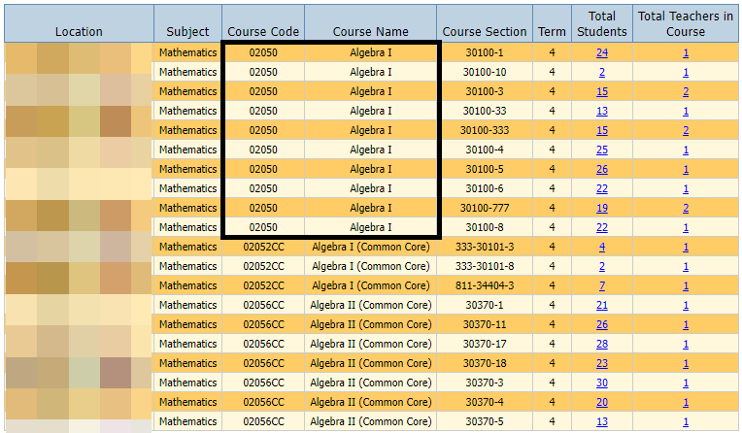
SIRS-330
The Algebra I state course code changed this year because the State is administrating a new Algebra I Regents exam.
Be sure you have the correct code!
It should be 02050

Slide 27
Student Digital Resources (District, BOCES, & Charters)
Annual and ongoing collection
A survey seeking to learn more about student access to technology at home
Survey is for parents/guardians, but you can survey students as well
Data due Thursday, January 25

Slide 28
NYSESLAT Pre-ID Data
Must report all 0231 - ELL Eligible and ELL Programs
ELL Eligible data is used by NYSED to identify students who need to take the NYSESLAT exam
If your data isn’t in L2RPT then you will not get pre-printed labels for your NYSESLAT answer sheets
Data is due Thursday, February 1

